Slide 1
DuckDB: An embedded database for data science
Pedro Holanda pedro@duckdblabs.com
Notes:
Hi everyone, so today is the first part of our duckdb tutorial. I will give a more high-level talk of why to use databases, in special duckdb, and next week my colleague Mark will talk about the internals of duckdb in more details.

Slide 2
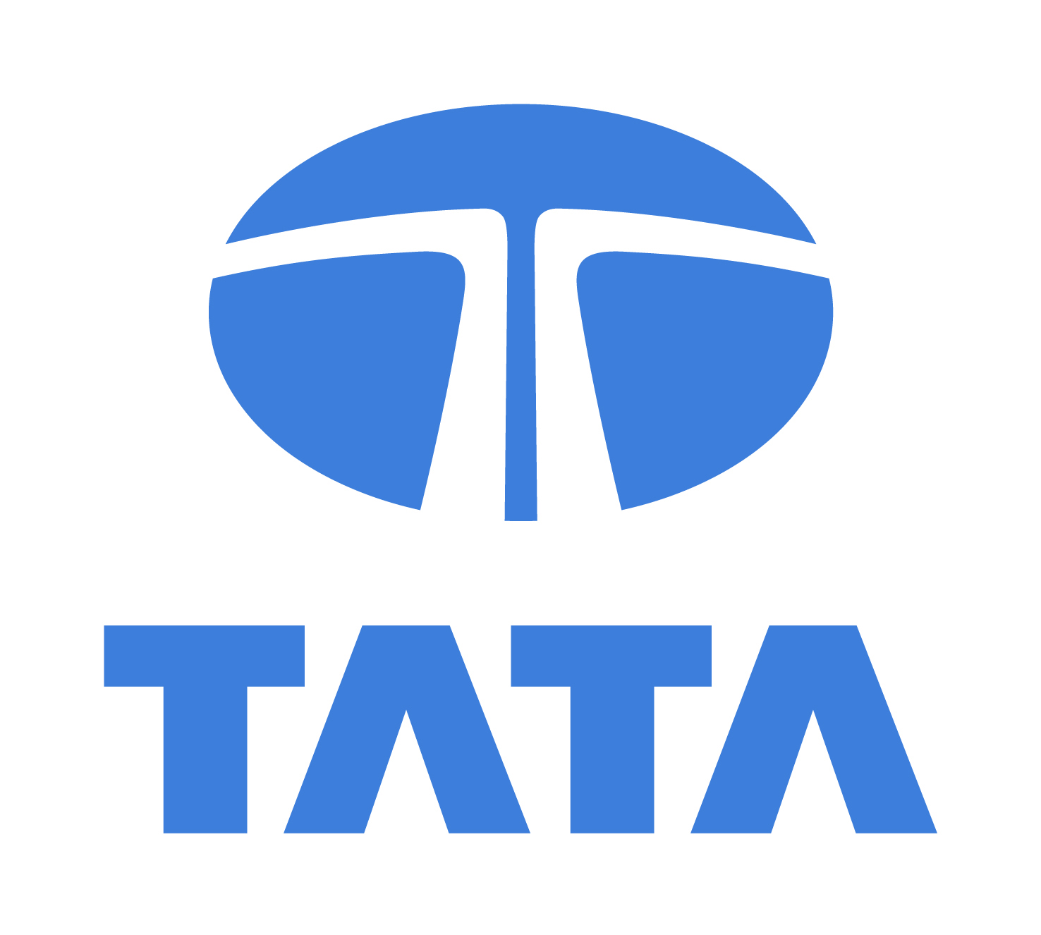

About Us
CWI in Amsterdam;
Database Architectures Group
Why a new system?
Most Projects at CWI are sponsored by private companies;
Most of our projects are related to data science (Particularly, ML pipelines);
Main goal is to optimize/facilitate the management of data in data science projects.
Notes:
So just to give you a bit of context about our research group, why are we interested in database systems and why are we developing, from scratch, a completely new database system.
I work for CWI, short for centrum Wiskunde en Informatica, sorry for my dutch. CWI is the research center for mathematics and computer science located in Amsterdam. More specifically, I work for the database architectures group, which is a group specialized on developing database systems. At CWI, we have shipped in the past twenty years two database systems that are widely known in the database community. Those systems are called MonetDB and Vectorwise and are state-of-the-art database systems for Analytical Queries.
So, if we already have two systems, why bothering doing a new one? The thing is most projects currently running at CWI are sponsored by private companies, and they are related to data science, particularly machine learning pipelines. For example we have projects with Tata Steel, the Honda Research Institute and KLM. Where our main goal is to optimize and facilitate the data management in these data science projects. And these previous systems were not well optimized for the data science case.

Slide 3
Outline
Notes:
So, lets talk a bit of what we will see today

Slide 4
Outline (Today)
Why should I use a Database System?
Combining Database Systems with Data Science.
DuckDB: An embedded database system for data science.
Hands-on ~ 45 min. [Using DuckDB]
Notes:
So today I have three goals, first is to motivate you guys to use database systems in your data science pipelines.
Second is to demonstrate how we can integrate previous data management solutions with data science and use that to motivate you why we really had to do a new database system from scratch.
Then I’ll talk about what makes duckdb special. And finally we will do a little exercise using duckdb and comparing it to other data management solutions.

Slide 5
Why should I use a database system?
Notes:
So, why should you use a database system?

Slide 6
Database Example
Database that models a digital music store to keep track of artists and albums.
Things we need to store:
Information about artists.
What albums those artists released.
This example is originally from: https://15445.courses.cs.cmu.edu/fall2019/slides/01-introduction.pdf
Notes:
Let’s start off with a simple example.
Let’s say we want to create a database that models a digital musical store, something like Spotify.
And we want to keep information about the artist and the albums they release.
The most trivial way to actually implement something like this is to use what is called flat files.

Slide 7
Flat File
Store database as comma-separated value (CSV) files that we manage in our own code
Use separate file per entity
The application has to parse files each time they want to read/update records
Notes:
Basically you have a text file, using a CSV and you have different files for different entities, one for artists, one for albums, and every single line of these files is related to one entry, either one artist or one album.
To operate on it, in our application code, we have to write our own code to manage these files. And for every search or update we must read and parse the entire file.
For example, if we want to do a lookup for particular entry, we need to open a file, look at every single line, separate the commas, and extract the one we want.

Slide 8
Flat File Example
Database that models a digital music store
Artist (name, year, country)
“Backstreet Boys”,1994,"USA"
“Ice Cube”, 1992,"USA
“Notorious BIG”,1989,USA
Album (name,artist,year)
“Millenium", "Backstreet Boys", 1999
“DNA”, “Backstreet Boys”, 2019
“AmeriKKKa's Most Wanted”, “Ice Cube”, 1990
Notes:
To give you a more clear example, here we have the artist and the album files.
In the artist we have their name, year they started, and country, and in the album file we have their names, the artists who made them and the year they were released.

Slide 9

Flat File Example
Get the year that Ice Cube went solo
Artist (name, year, country)
“Backstreet Boys”,1994,"USA"
“Ice Cube”, 1992,"USA
“Notorious BIG”,1989,USA
Notes:
Let’s say I want to know when Ice Cube went solo, he was part of N.W.A before, but at some point he left the band for money reasons.
To know this I need to open the file, and for each line I parse it and check if its what we are looking for. Basically this little python snippet here.
But there are a tons of problem with this solution. In the next two slides I’ll give you a couple of examples.

Slide 10
Data Integrity
How do we ensure that the artist is the same for each album entry?
What if someone overwrites the album year with an invalid string?
How do we store that there are multiple artists on an album?
Notes:
Lets first talk three problems with data integrity.
The first problem is, how do we ensure that the artist is the same for each album entry. For example, imagine ice cube changes his name to melted ice for whatever reason. Then we have to make sure to update his name all over the document.
Second problem is, what if someone changes the album year and put some funky string there?
Remember these are text files, so there is nothing that can stop a person from opening it and just changing values to gibberish.
Third problem is, how do I model multiple artists on an album? If Ice cube and Notorius Big make an album together, we repeat lines to each artist? Then we have to take care of that in the application code

Slide 11
Implementation
How do we find a particular record?
What if we now want to create a new application that uses the same database?
What if two threads try to write to the same file at the same time?
Notes:
The next set of problems are related to the implementation of the application that uses this data.
First, how we find a particular record? Imagine billions of entries, then every time we want to get a particular record we might have to open this huge file, parse and scan it until the end.
Second, if we want to have another application using these files? Now we have to copy all the code that reads and updates these files to the new application and make sure that they are both in sync.
Third, is what if we have two threads both trying to update the same file at the same time?
Do we let the os deal with it? then its going to be the last writer, which means we will lose data from the first writer.

Slide 12
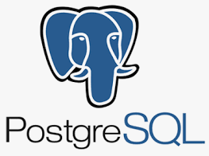


Database Management System
Software that allows application to store and analyse information in a database.
A general-purpose DBMS is designed to allow the definition, creation, querying, update and administration of databases.
Notes:
The answer for all these problems lies in a database management system.
A Database Management System is software specifically designed to store and query a database.
The overall idea is, instead of writing code to manage data in your flat files, a database management system will do this for you. In that way you can care on just writing the logic of application.

Slide 13
Motivation
Many data scientists do not use database systems
Despite requiring many of the things they offer!
Data management, data wrangling…
Instead: Engineer their own solutions
Flat files to store data (CSV, Binary, HDF5, etc).
dplyr/pandas as query execution engines.
Notes:
In practice, many data scientist do not use database systems.
Although they require many things a database system offers.
Instead they go for exactly the scenario I’ve talked about, with the difference they use libraries like dplyr or pandas to process their data.

Slide 14
What is the problem?
Manually managing files is cumbersome.
Loading and parsing e.g. CSV files is inefficient.
File writers typically do not offer resiliency.
Files can be corrupted;
Difficult to change/update.
It does not scale!
Why people use it?
A pip install and you ready to go.
$ pip install pandas, numpy
Notes:
And using these libraries have exactly the same problems I’ve talked before. You have to manually manage files, its expensive to load and parse them. There is no guarantee your data won’t be corrupted. Its not easy to change your data, and does not scale for bigger files.
So why people use it?
The main reason is because it is easy.
The developer just need to install the package he wants to use, and he is good to go.
And the APIs are also quite simple to use.

Slide 15
Dplyr; Pandas; DataFrames - What is the problem?
The problem is that they are very poor query engines!
Materialize huge intermediates
No query optimizer
Not even for basics like filter pushdown
No support for out of memory computation
No support for parallelization
Unoptimized implementations for joins/aggregations
Notes:
And all of that is only part of the problem.
In general these libraries are very poor query engines.
They materialize huge intermediates. They have no query optimizer, even a simple filter pushdown will not be optimized. They have no support for out of memory computation. No support for parallelization and slow implementations for joins and aggregations.

Slide 16
Data Science
Data scientists need the functionality database systems offer
But they opt not to use database systems
Often this leads to problems down the road
When the data gets bigger…
When a power outage corrupts their data…
Notes:
By now I hopefully convinced you guys, that data scientis need the functionality database systems offer, even though they opt not to use them.
Which often leads to problems down the road, when data gets bigger or something unexpected happens and their data is corrupted.

Slide 17
Combining Database Systems with Data Science
How can we combine analytical tools (R/Python) with database systems?
Notes:
So, enough about flat files, how can we combine data science with database systems?
In other words, ow can we combine our analytical tools, think of R and Python scripts

Slide 18
How?
Database Client Connections
User Defined Functions
Embedded Database Systems
Notes:
There are 3 primary ways, either by using a database client connection, by writing User Defined Functions and through embedded database systems

Slide 19
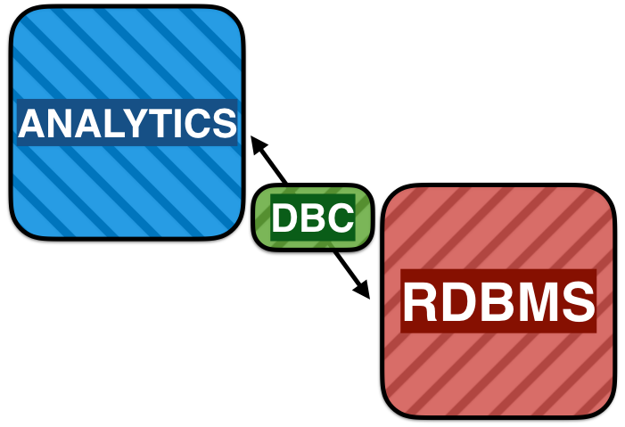
Database Client Connections
1: DB Connection
DBMS is separate process
Queries & Data transferred over socket
Problems:
Data transfer is very slow (both directions)
Requires setup & management of DBMS server
Notes:
The classical way ,is by starting a database server and requesting data from the server to your analytical process.
The data is then transferred over the socket, and most computation is performed in the analytical process.
There are two problems with this solution. First is that data transfer if very slow in both directions, from either the database to your python script, or from your python script to your database, and that this actually requires a lot of work to setup.

Slide 20
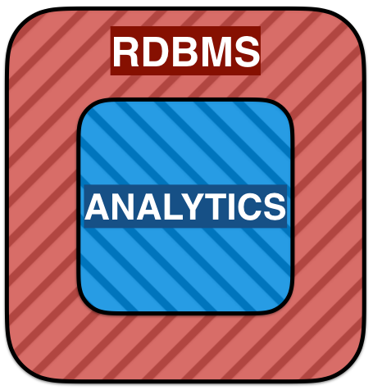
2. User Defined Functions
Most cases a data scientist exports data from the RDBMS to the analytical tool
User-Defined Functions (UDFs)
Analytics is run inside DBMS server
No separate analytics program!
Problems:
Difficult to implement and debug
DBMS-specific, requires knowledge of DBMS internals
Also requires setup & management of DBMS server
Notes:
Well, we know that in most cases data scientist exports the data from the database system to the analytical tool, so we can’t really spend a lot of time on data transfer.
So, user defined functions are a more promising solution, the basic idea is the analytical process runs inside the database server, hence we do not have to transfer data outside the database system.
The problem is that these UDFs they are a nightmare to implement and debug, they require a lot of the database system knowledge, and its also annoying to setup the server.

Slide 21
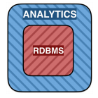

3. Embedded Databases
It runs inside the analytics applications;
Has same low-transfer cost advantages as UDFs;
Are easy to install/use;
Binds to almost every language.
What the most famous embeddable DBMS?
Runs on every phone, browser and OS
It even runs inside airplanes!
Great for transactions, not so good for analytics.
Notes:
Well, but what if I told you, there is actually a way, that is simple to install, easy to develop and debug and that also has no transfer costs. They actually exist, and are known as embedded database systems.
The idea is that the database runs inside the analytical application, so again you don’t have do transfer data from outside your process.
They are as easy to install and use as the analytical libraries and bind to almost every language, so its the same thing, a simple pip install, and small changes in your script and you are good to go.
The most famous one is SQLite, it is secretly the most used Database System, running on every phone, browser os and even inside airplane.
The only problem is that SQLite is highly optimized for transactions and not really for analytics.
So its really optimized, for updates, inserts and deletes but not really for performing computation in massive amounts of data.

Slide 22
Notes:
And that question is what motivated our group into starting a complete new database system from scratch.

Slide 23

DuckDB’s Core Features
DuckDB: The SQLite for Analytics
Simple installation
Embedded: no server management
Fast analytical processing
Fast transfer between R/Python and RDBMS
Duckdb is currently in pre-release
Check duckdb.org for more details.
$ pip install duckdb
Notes:
The idea is to have a sqlite for analytics.
So we want it to be simple to install, as simple as doing a pip install duckdb, we want it to be embedded, so there is no server management, we want it to have a fast analytical database engine, and have faster transfers between R/Pyhton analytical tools and the database.
And although duckdb has been in development for only two years, its already in pre-release, and you can check the website if you want to try it out on your own project

Slide 24
What makes duckdb special?
Data Science is equal to Analytical Processing!
Storage Model
Row-Store vs Column-Store
Compression
Query Execution
Row-wise vs vector-wise
Relational API
Notes:
So what are the reasons that make duckdb faster than sqlite for data science?
The first is, that data science is equal to analytical processing.
So a lot of design decisions are done to optimize for these types of workloads.
To cite a few, duckdb’s storage model is a column store, it heavily focuses on compression possibilitites, it uses a vector-wise query engine and will allow for progressive index creation.

Slide 25
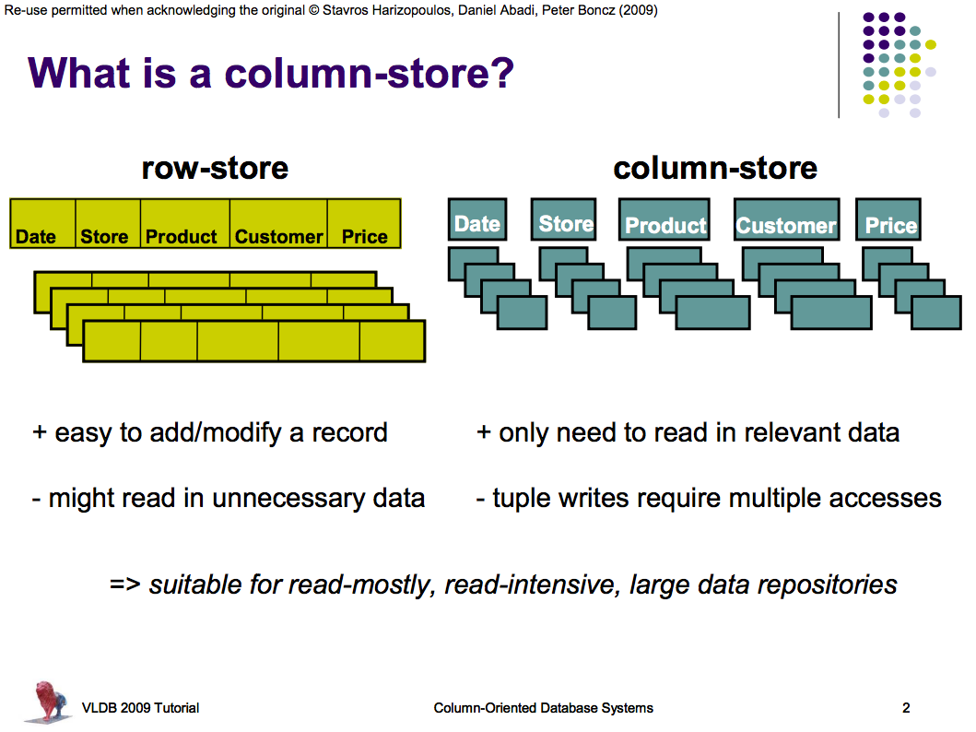
Storage Model
SQLite use a row-storage model
DuckDB uses a columnar storage model
Notes:
Sqlite uses a row storage model, while duckdb uses a columnar storage model.

Slide 26
Storage Model
Row-Storage:
Individual rows can be fetched cheaply
However, all columns must always be fetched!
What if we only use a few columns?
e.g.: What if we are only interested in the price of a product, not the stores in which it is sold?
Notes:
In a row storage model, the rows are stored continuously in memory.
That means that individual rows can be fetched cheaply, however you must always fetch all columns from the row.
The thing is, in analytical processing, is very common that we are interested only in a few columns of a table, so for example we might be interested only in the price of the product and not really in which stores it is sold.

Slide 27
Storage Model
Column-Storage:
We can fetch individual columns
Immense savings on disk IO/memory bandwidth when only using few columns
Notes:
The column-storage stores each column's data continuously, which means we can now fetch individual columns and have immense savings on disk io or memory bandwidth when using just a few columns.

Slide 28
Storage Model
Example: Suppose we have a 1TB table with 100 columns. We have a query that requires 5 columns of the table.
Row-store: Read entire 1TB of data from disk at 100MB/s ≅ 3 hours
Column-store: Read 5 columns (50GB) from disk ≅ 8 minutes
Notes:
For example, suppose we have a table with 1tb data and 100 columns, but we are only interested in 5 columns of this table.
In a row store, reading this 5 columns means reading the full table, which at 100 megabytes per second, would take us about 3 hours.
In a column store, these same 5 columns, can be fetched independently, so we only need to read 50 gigabytes of data, which takes about 8 minutes.
So you can see, that with this simple change, there is already a huge impact in performance.

Slide 29
Compression
Compressibility is another advantage of column-storage
Individual columns often have similar values, e.g. dates are usually increasing
Save ~2-10X on storage (depending on compression algorithms used and data)
Notes:
Second advantage of duckdb is compressibility.
Individual columns ofter store similar values, for example increasing dates. So depending on the compression algorithm used and your data you could save two to 10 times on your storage.

Slide 30
Compression
Example: Suppose we have a 1TB table with 100 columns. We have a query that requires 5 columns of the table.
No compression: Read 5 columns (50GB) from disk ≅ 8 minutes
Compression: Read 5 compressed columns (5GB) from disk ≅ 50 seconds
Notes:
If we go back to our example with a table of one terabyte and 100 columns. and our query that reads 5 columns from the table. Reading the uncompressed data would be equivalent to reading 50 gigabytes from disk, so approximately eight minutes, while if the data is compressed, assuming we can reduce its size by a tenth, it would be equivalent to reading 5 gigabytes from disk, so approximately 50 seconds.

Slide 31
Query Execution
SQLite use tuple-at-a-time processing
Process one row at a time
NumPy/R use column-at-a-time processing
Process entire columns at once
DuckDB uses vectorized processing
Process batches of columns at a time
Tuple-at-a-Time
Column-at-a-Time
Vectorized Processing
Table
Result
Table
Result
Table
Result
Notes:
Third point is the execution engine.
Sqlite uses a tuple-at-a-time processing, which means one row is processed per time.
Numpy or R uses column-at-a-time processing, which means the entire column is processed at once.
And duckdb uses vectorized processing, where column batches are processed at a time.

Slide 32
Query Execution
Tuple-at-a-Time (SQLite)
Optimize for low memory footprint
Only need to keep single row in memory
Comes from a time when memory was expensive
High CPU overhead per tuple!
Tuple-at-a-Time
Column-at-a-Time
Vectorized Processing
Table
Result
Table
Result
Table
Result
Notes:
The tuple at a time model from sqlite, is optimized for a low memory footprint, since you only need to keep one row in memory, and it comes from a time when memory was expensive. Since we always call all functions that operate on our data once per tuple it incurs a high cpu overhead per tuple.

Slide 33
Query Execution
Column-at-a-Time (NumPy/R)
Better CPU utilization, allows for SIMD
Materialize large intermediates in memory!
Intermediates can be gigabytes each…
Problematic when data sizes are large
Tuple-at-a-Time
Column-at-a-Time
Vectorized Processing
Table
Result
Table
Result
Table
Result
Notes:
In the column at a time we have better cpu utilization, since we call each function that operated on the data only once and allows for SIMD instructions.
But we must materialize intermediates in memory.
Which means that for every operation we need to have space to materialize the intermediates it produces.

Slide 34
Query Execution
Vectorized Processing (DuckDB)
Optimized for CPU Cache locality
SIMD instructions, Pipelining
Small intermediates (ideally fit in L1 cache)
Tuple-at-a-Time
Column-at-a-Time
Vectorized Processing
Table
Result
Table
Result
Table
Result
Notes:
So duckdb is the best of both worlds, it reduces the amount of function calls by operating in batches of the data, and is actually even faster than the column at a time model because it optimizes for CPU Cache Locality.

Slide 35
Query Execution
Vectorized Processing
Intermediates fit in L3 cache
Column-at-a-Time
Intermediates go to memory
cpu core
l1 cache (32KB)
latency: 1ns
l2 cache (256KB)
latency: 5ns
l3 cache (20MB)
latency: 20ns
Main Memory (16GB-2TB) latency: 100ns
Notes:
I’m not sure if everyone here is familiarized with the layout of a modern computer.
You basically have a CPU core, with a bunch of caches underneath and the main memory
And you have this hierarchy there, where the cache sized get bigger but it's slower to access them.
You can see there is a factor 100 between L1 and Main Memory, and when you are constantly fetching data this blows up, and becomes a major bottleneck in data processing.
The problem with the column at a time model is that the data is main memory resident, imagine the 1gb column, where do you put it? It does not fit in L1, L2 or L3, so you need to store it in main memory, which means every time you fetch data from it you need the main memory access cost.
The nice thing about the vectorized process is that by keeping it small, you can make it fit in L3, which causes you to access L3 cache being much faster.

Slide 36
Query Execution
cpu core
l1 cache (32KB)
latency: 1ns
l2 cache (256KB)
latency: 5ns
l3 cache (20MB)
latency: 20ns
Main Memory (16GB-2TB) latency: 100ns
Notes:
I’m not sure if everyone here is familiarized with the layout of a modern computer.
You basically have a CPU core, with a bunch of caches underneath and the main memory
And you have this hierarchy there, where the cache sized get bigger but it's slower to access them.
You can see there is a factor 100 between L1 and Main Memory, and when you are constantly fetching data this blows up, and becomes a major bottleneck in data processing.
The problem with the column at a time model is that the data is main memory resident, imagine the 1gb column, where do you put it? It does not fit in L1, L2 or L3, so you need to store it in main memory, which means every time you fetch data from it you need the main memory access cost.
The nice thing about the vectorized process is that by keeping it small, you can make it fit in L3, which causes you to access L3 cache being much faster.

Slide 37
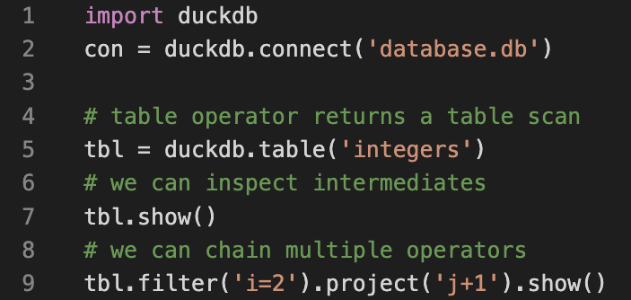
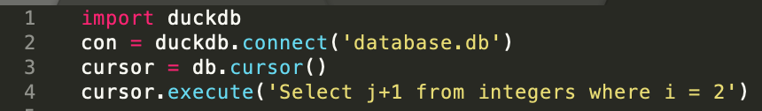
Relational API
One of the reasons data scientists love libraries like pandas is their easy API.
Database Systems forces developers to use SQL
In DuckDB we have been developing a new API, called relational API that resembles the API of libraries like Pandas.
Relational API
DB API
Notes:
Final thing I want to talk about is the relational API.
One of the things that data scientists love about libraries like pandas is their easy to use API.
While database systems forces developers to write SQL, which is hard to debug, and difficult to write since is just a string in our python application.
In duckdb we have been developing a new API, called relation API that resembles API’s from libraries like Pandas.
As one example in the left we have the classical API, where we must acquire a cursor from a connection and issue queries through the cursor.
In the right we have the relation api, where we can create operators, in line 5 we have an operator that returns a table scan, we can inspect them with show and we chain multiple operators, for example a filter and projection operators.

Slide 38
Hands-on
Notes:
So enough talking, now it is time for us to go to our hands-on

Slide 39
Hands-on
Goal: See in practice the differences of:
Pandas;
DuckDB.
Tasks (Benchmark):
Queries (e.g., aggregations, filters and joins);
Transactions.
Notes:
The goal of our hands-on is to see in practice the differences of Pandas, and DuckDB.
So we will load the data, perform some queries and transactions on these two libraries and we will also try our the relational api out.
We will be using the colab environment for this, so upload the exercise there and take sometime to setup accounts if necessary

Slide 40
Hands-on
Right Now:
Clone Repo: https://github.com/pdet/duckdb-tutorial
Upload file: Part 1/Exercise/Exercise.ipynb to https://colab.research.google.com/ as a Python 3 Notebook.

